Slide 1
Digital Assistant for Legal Awareness and Designing a KYR Know-Your-Rights framework in India
PIP2001 Capstone Project
Review-0
Batch Number: COM-10
Under the Supervision of,
Dr./Mr./Ms./Prof. Dr. Sudha P
Assistant Professor - SCSE
School of Computer Science and Engineering
Presidency University
Roll Number | Student Name
20211COM0071 | P SAI TEJA
20211COM0093 | VISHNU PRIYA S
20211COM0074 | VAISHNAVI A L
20211COM0096 | SUJAN T
Name of the Program: Computer Engineering
Name of the HoD: Dr. Gopal Krishna Shyam
Name of the Program Project Coordinator: Dr. Sudha P
Name of the School Project Coordinators: Dr. Sampath A K Associate Professor(SG), Dr. Abdul Khadar A Associate Professor, Mr. Md Ziaur Rahman

Slide 2
Content
Problem Statement
Github Link
Analysis of Problem Statement
Timeline of the Project
References

Slide 3
Problem Statement Number:
Organization:
Category (Hardware / Software / Both) : Software
Problem Description: Digital Assistant for Legal Awareness and Designing a KYR Know-Your-Rights framework in India
Difficulty Level: Miscellaneous (Smart Education)

Slide 4
Github Link
The Github link provided should have public access permission.
Github Link

Slide 5
Analysis of Problem Statement
Technology Stack Components
1. Frontend (User Interface)
Web App: React.js, TailwindCSS
Mobile App: Flutter / React Native
Voice & Chat UI: Google Dialogflow, Microsoft Bot Framework
2. Backend (Business Logic)
API Development: Node.js with Express / Python (Django/Flask)
Database: PostgreSQL (structured legal info) + MongoDB (chat history)
Authentication: Firebase Auth, OAuth 2.0
3. AI & NLP Processing
Natural Language Processing (NLP): OpenAI GPT / Custom BERT Model
Speech-to-Text & Text-to-Speech: Google Cloud Speech-to-Text, Azure Speech Services
Legal Knowledge Graph: Neo4j (to structure legal entities & relationships)
4. Cloud & Infrastructure
Hosting: AWS EC2 / Google Cloud Run / Azure App Services
Storage: AWS S3 / Google Cloud Storage
Containerization: Docker, Kubernetes (for microservices deployment)

Slide 6
Analysis of Problem Statement (contd...)
Software Requirements:
Component | Description
Operating System | Windows, Linux (for servers), Android, iOS (for mobile users)
Database | PostgreSQL / MongoDB (to store legal information & user queries)
Backend Framework | Node.js (Express), Django, or Flask
Frontend Framework | React.js (for web app), Flutter/React Native (for mobile app)
AI & NLP Models | OpenAI GPT, Google Dialogflow, or Custom BERT-based models
Speech-to-Text API | Google Speech API / Mozilla DeepSpeech (for voice-based queries)
Authentication | OAuth 2.0, Firebase Auth (for secure login)
Cloud Storage | AWS S3 / Google Cloud Storage (for legal documents and case studies)
Legal Data APIs | Indian Kanoon API / Government Open Data APIs

Slide 7
Analysis of Problem Statement (contd...)
Hardware Requirements:
Component | Specification
Server (for AI processing & DB hosting) | Cloud-based (AWS/GCP/Azure) with GPU for AI workloads
End-User Devices | Smartphones (Android/iOS), Laptops, Tablets
Network Requirements | Stable internet connection (3G/4G/5G) for mobile users
Voice Assistant Integration (optional) | Smart speakers (Alexa, Google Assistant)

Slide 8
Analysis of Problem Statement (contd...)
In India, a nation characterized by a rich tapestry of laws encompassing diverse legal domains
such as family law, property law, labor law, and criminal law, a significant portion of the
population remains unaware of their legal rights and entitlements. This lack of legal literacy
perpetuates injustices, restricts access to justice, and hinders the effective utilization of legal
provisions designed for the benefit of the people. Additionally, societal taboos and the fear of
judgment deter individuals, particularly victims of sensitive cases like sexual assault and
domestic violence, from seeking legal assistance. Moreover, limited collaboration between
citizens and legal aid providers often leads to outdated or inaccessible legal information.

Slide 9
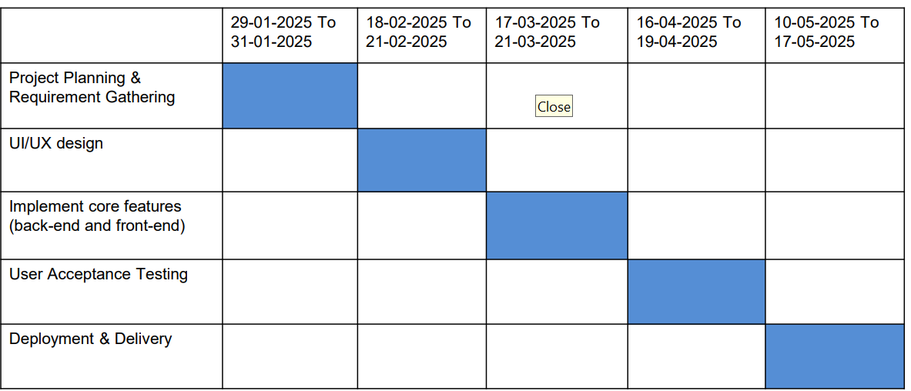








Timeline of the Project (Gantt Chart)

Slide 10
References (IEEE Paper format)
Add APA Citation for all references.
Use the below link for various APA styles :
https://www.indeed.com/career-advice/career-development/how-to-cite-a-research-paper

Slide 11


